Slide 1









Sport Products Sales Data Analysis
Presenters
Ahmed Osama
Hassan Reda
Mohamed El Dardiri
Mustafa Maher
Mohab Mohamed
Mohamed Mostafa

Slide 2

Agenda
Introduction and Project Objectives
Dataset Overview and Data Analysis Process
Visualizations and Dashboards

Slide 3

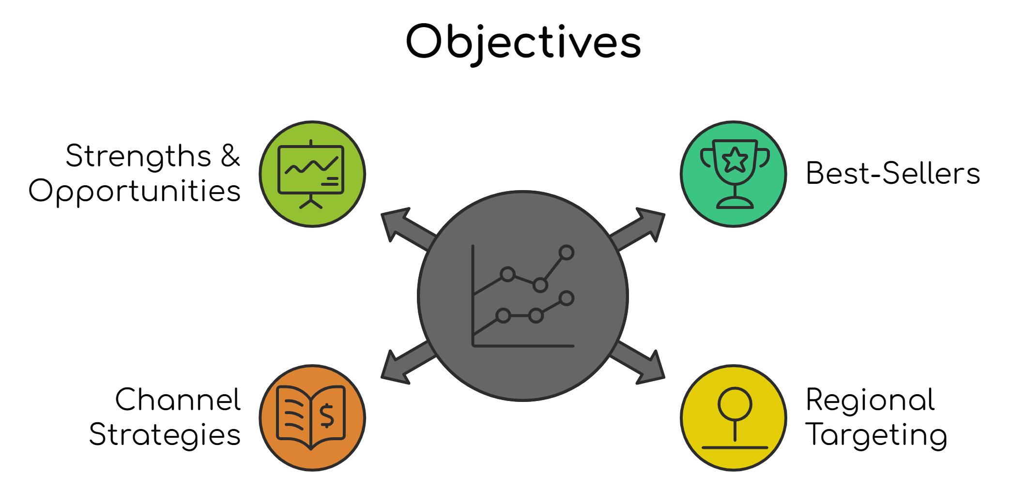
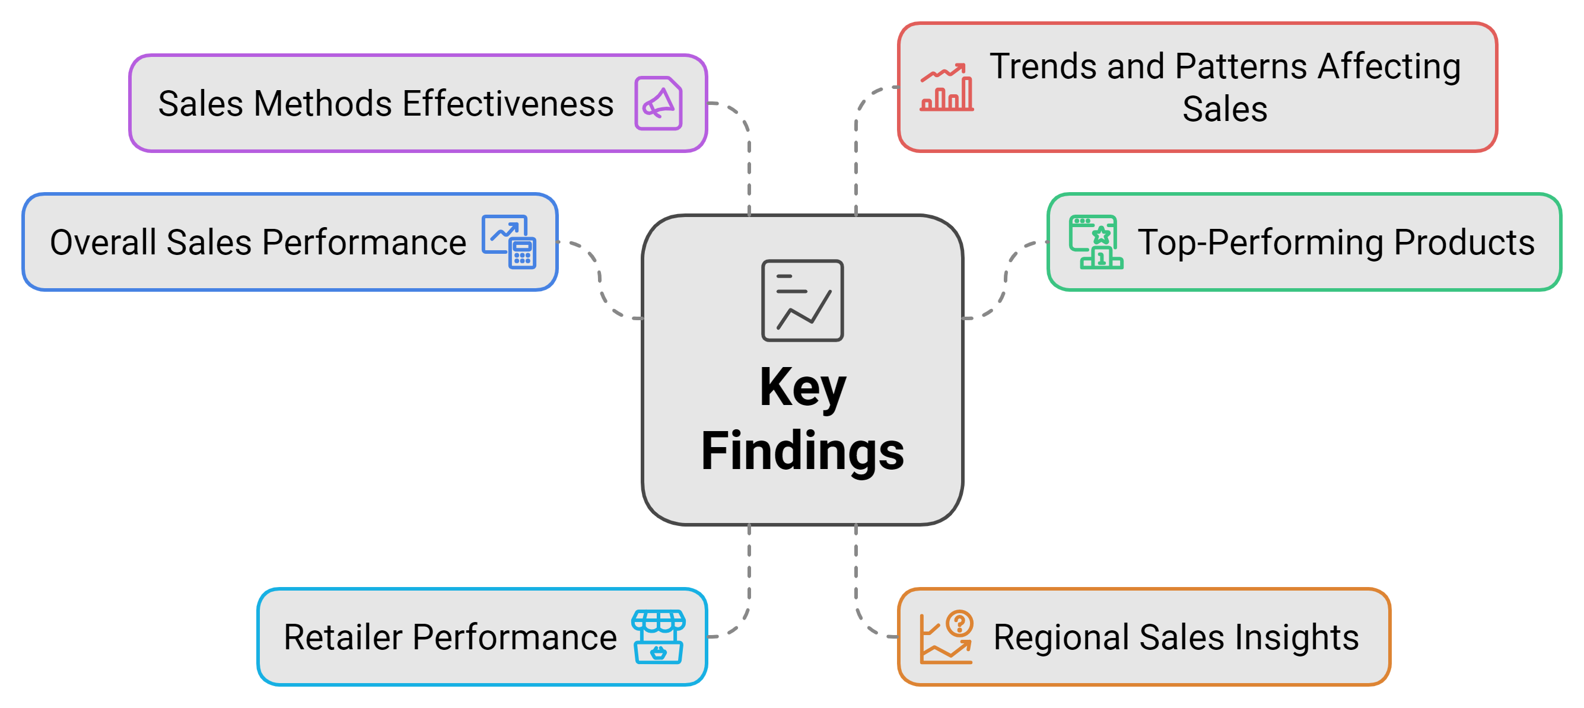
Introduction
Purpose
Comprehensive Sales Data Analysis by utilize Microsoft Power BI to thoroughly analyze our sales data and aim to transform raw data into meaningful insights.

Slide 4

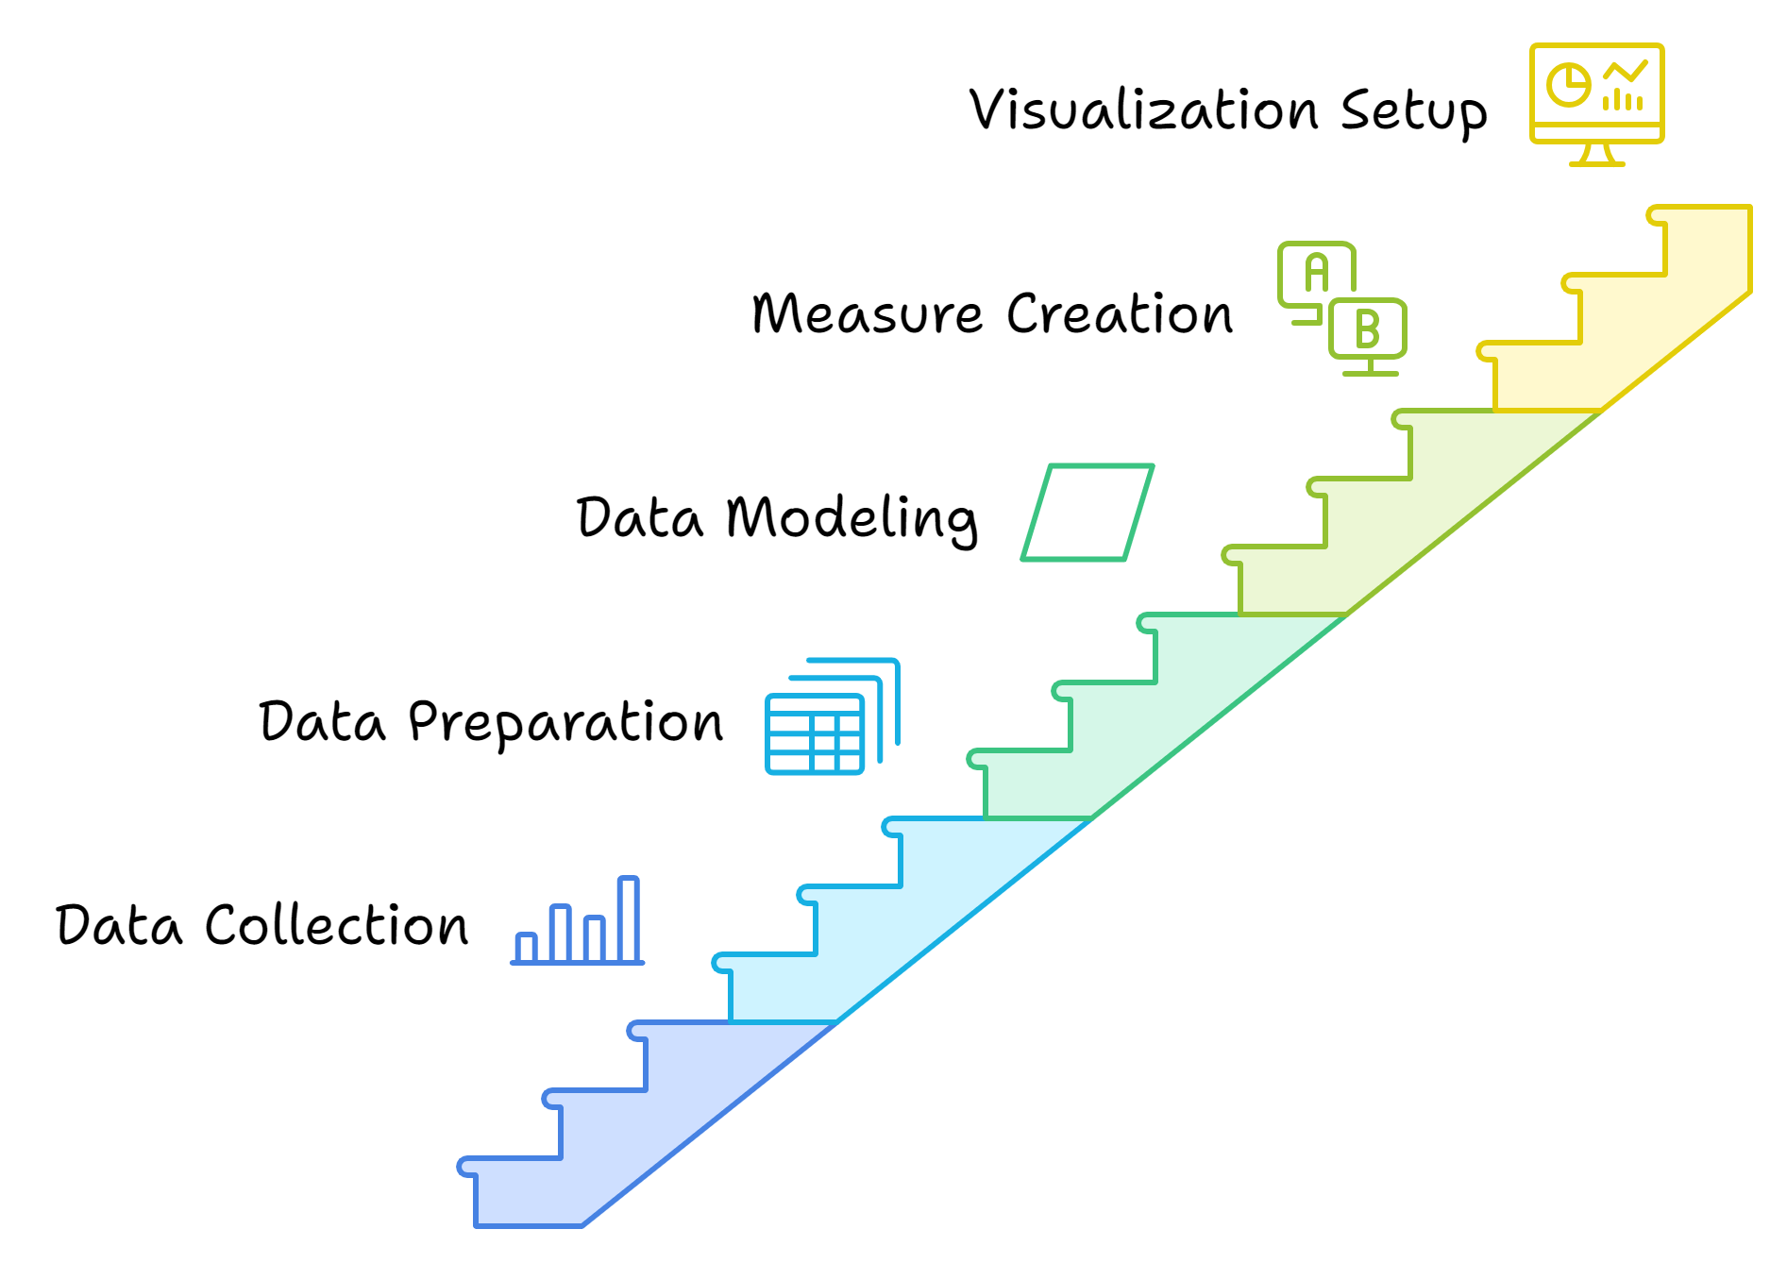
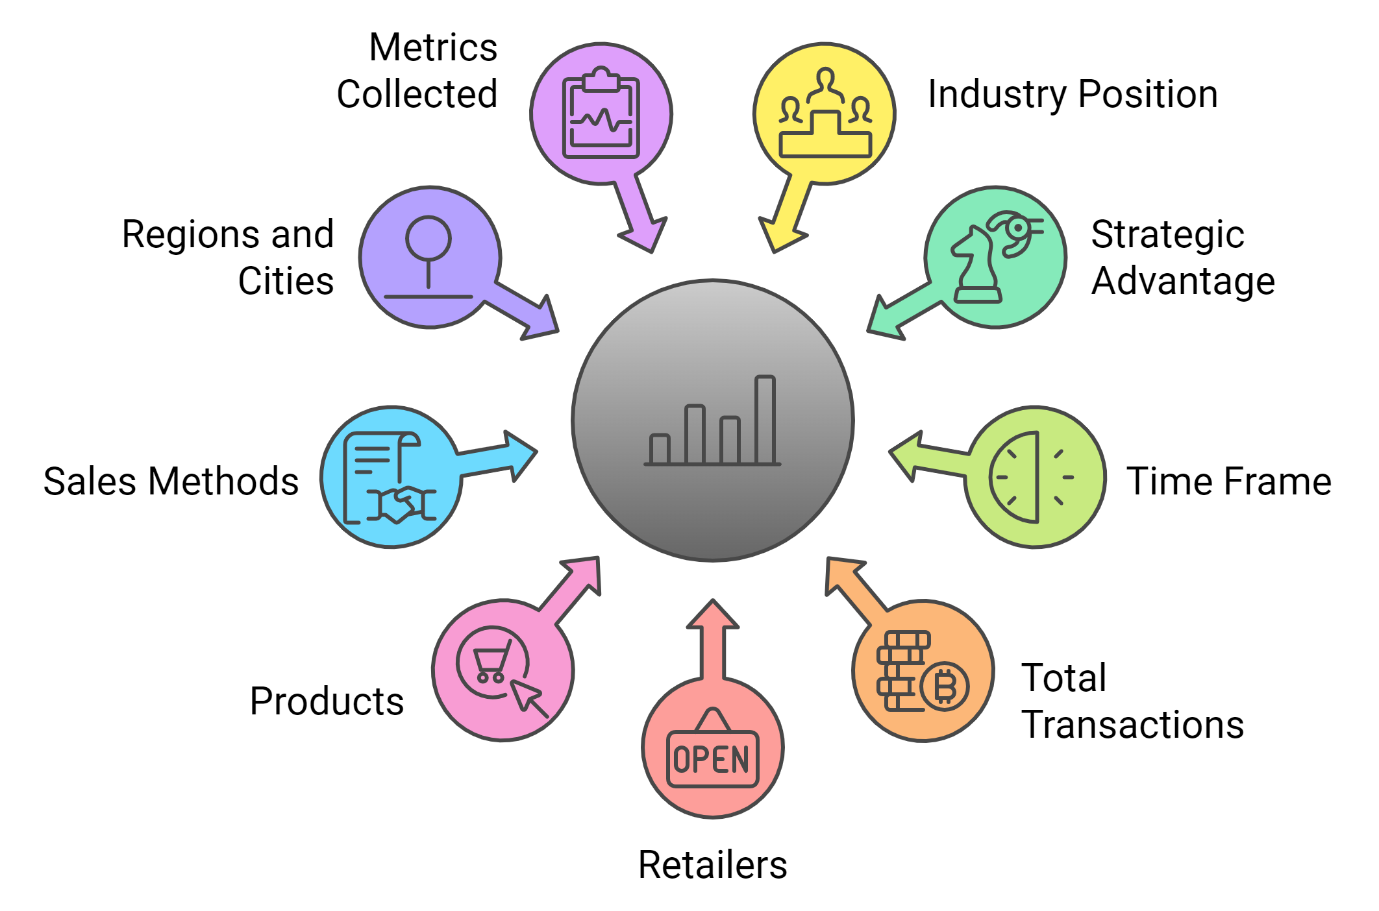
Dataset Overview
Dataset Description
Data Analysis Process

Slide 5
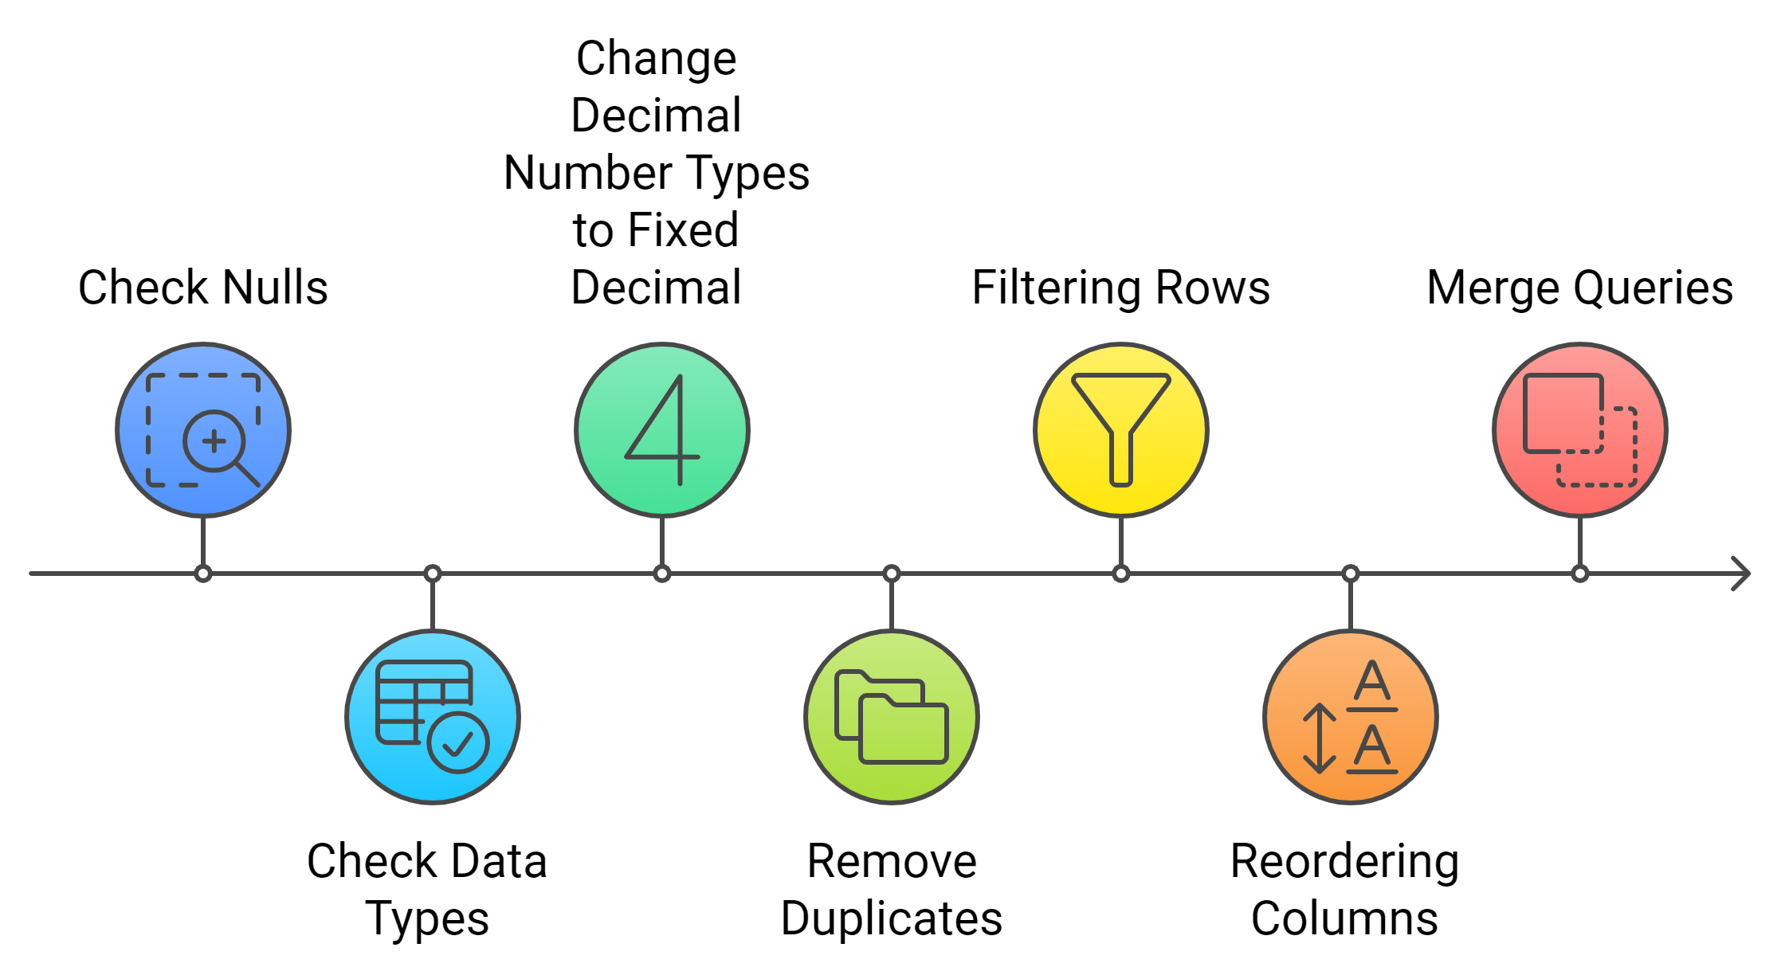
Data Transforming

Slide 6
Product Sales Performance Overview
“
”

Slide 7
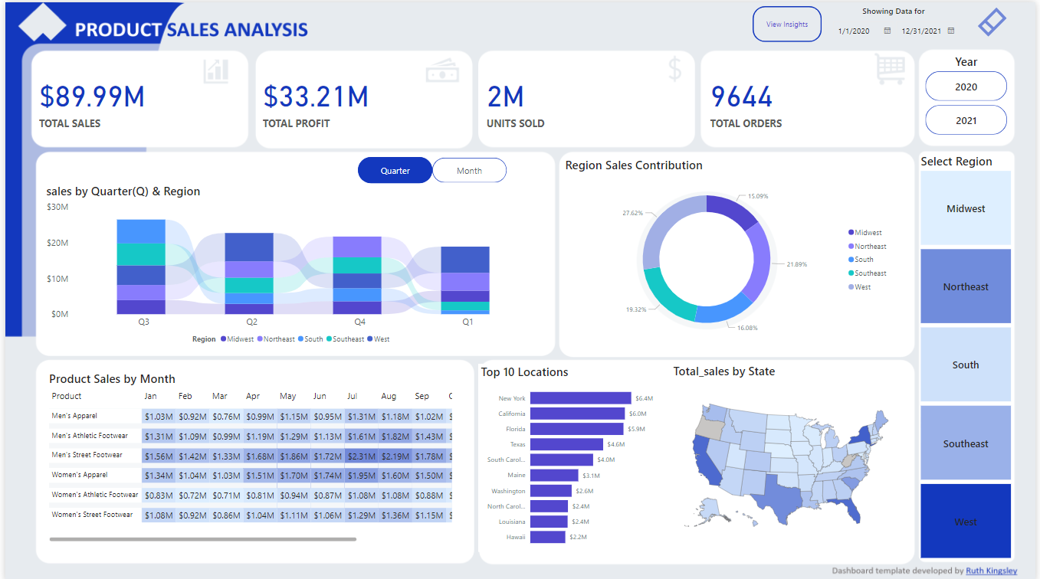

Slide 8
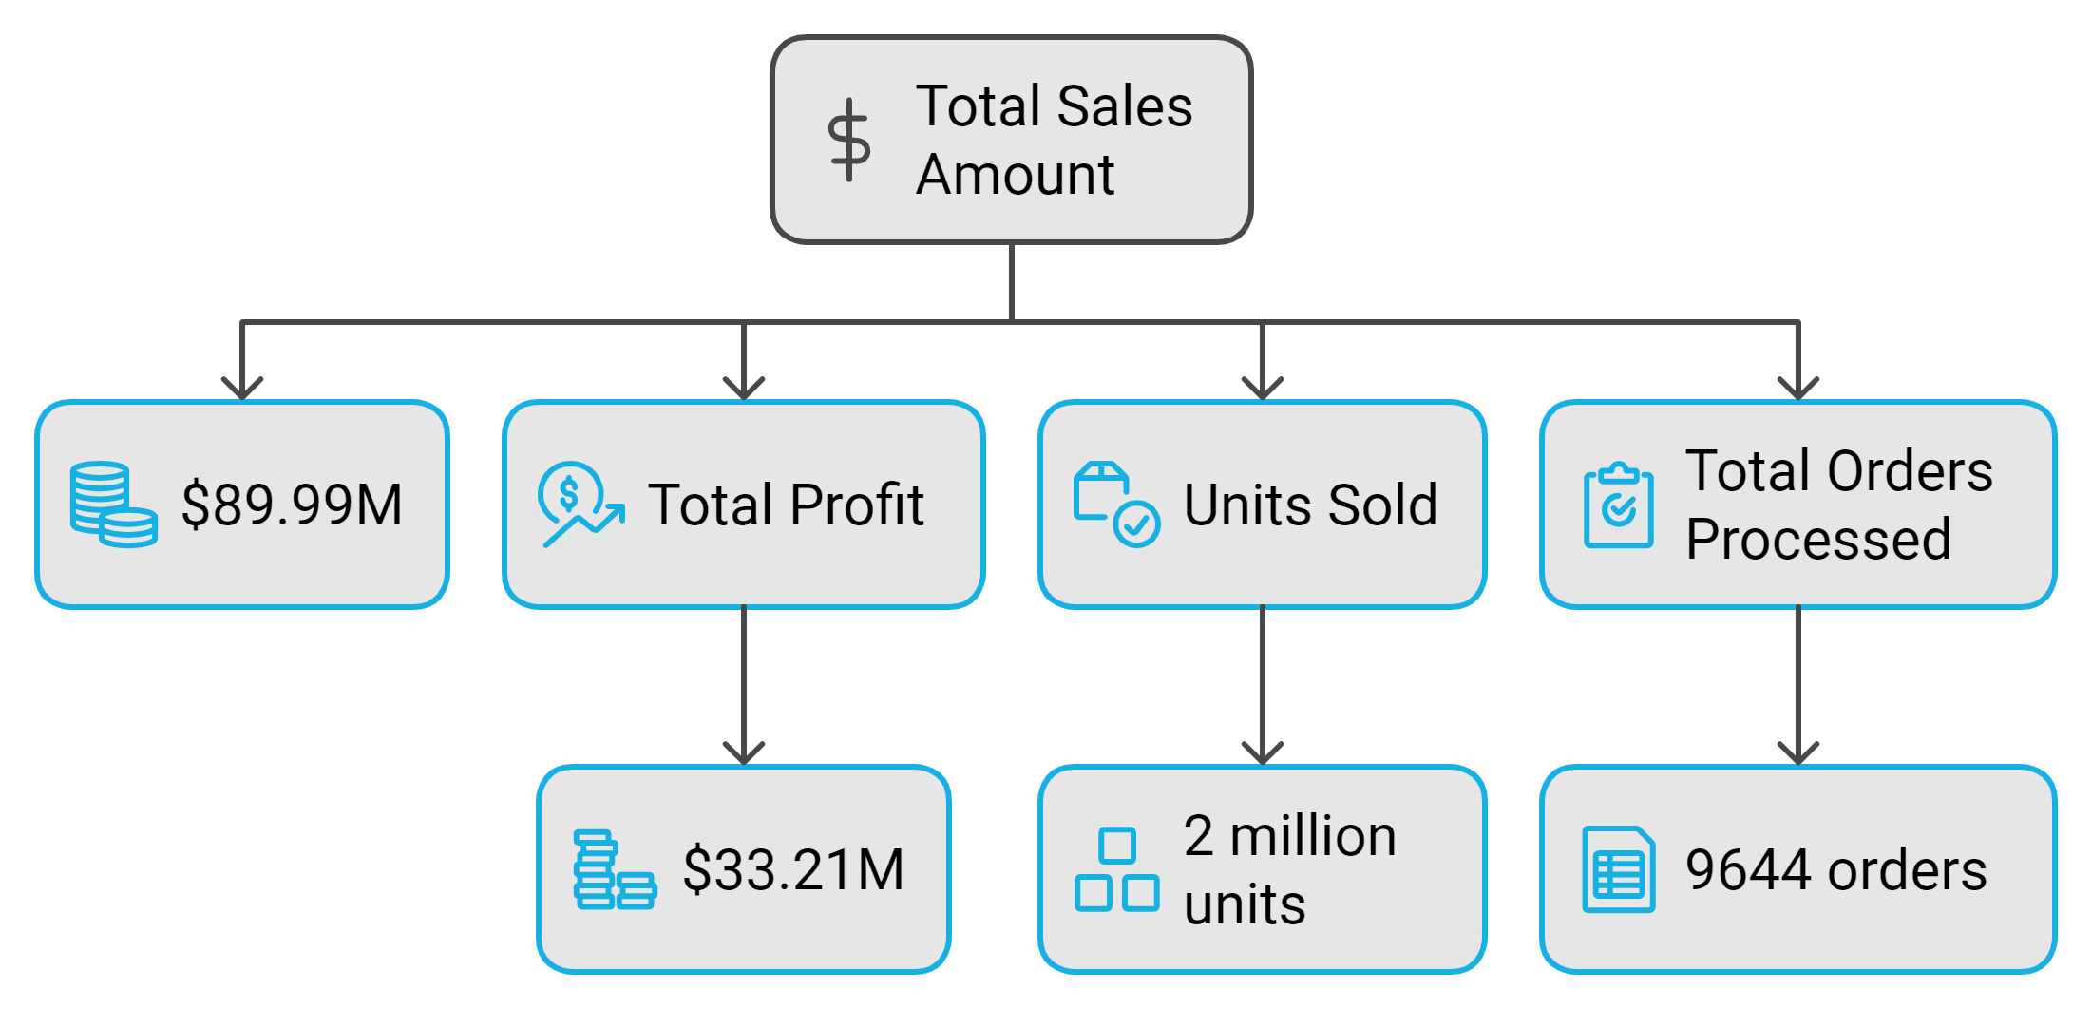
What are the total sales, profit, units sold, and total orders processed during the selected time period?

Slide 9
Product Sales & Performance
“
”

Slide 10
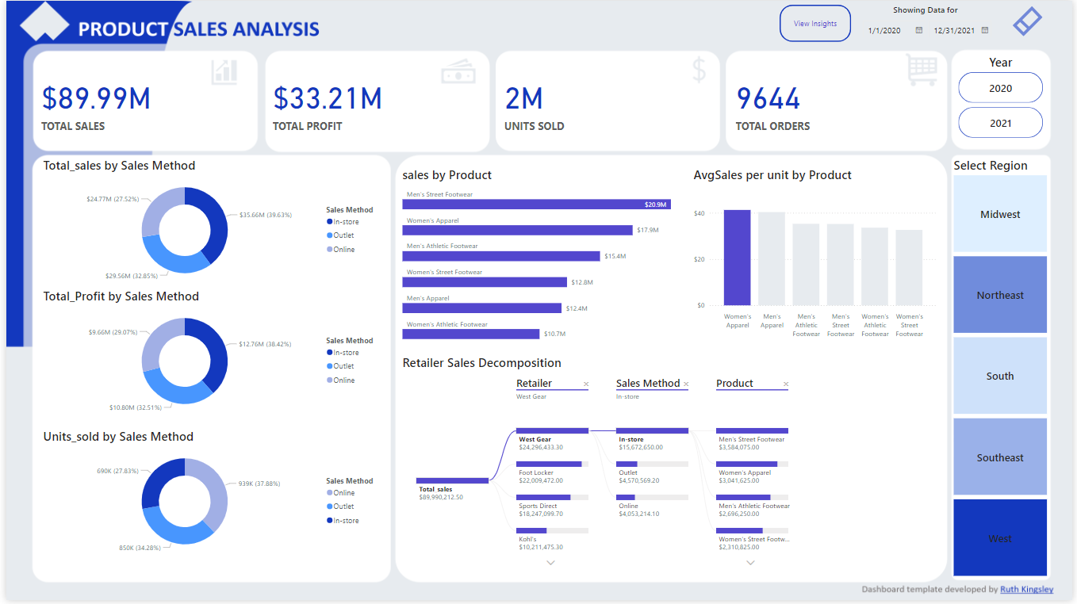

Slide 11

Thank you

